Slide 1
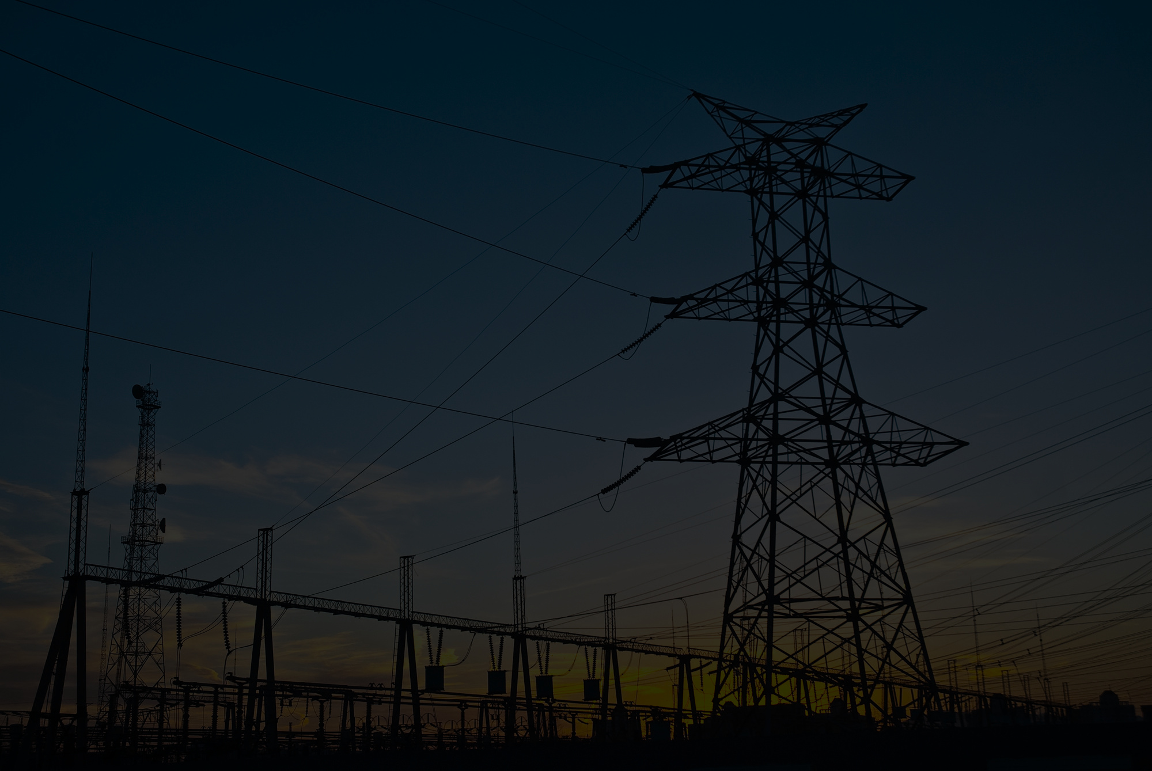
Presentation on
"Forecasting Electricity Generation and Consumption in Bangladesh: A Comparative Study of ARIMA, VECM, and LSTM Models"
Presented By
Md Forhad Hosen
ASH2015026M

Slide 2

Page 01
Introduction
Over Consumption Problems
Supply Shortages
Increased Costs
Resource Depletion
Environmental Impact
Grid Instability
Economic Strain
Accurate electricity forecasting is essential for Bangladesh's energy planning, given rapid population growth, urbanization, and industrialization. Electrification has reached 99.5% in 2023, and installed capacity has expanded significantly. However, overestimating or underestimating demand can lead to supply shortages or excessive investments, impacting the economy. This study compares three forecasting models — ARIMA, VAR, and LSTM — to predict electricity generation and consumption, aiming to support policy decisions and infrastructure planning.
Over Generation Problems:
Overcapacity
Financial Burden
Environmental Impact
Higher Operational Costs
Resource Wastage

Slide 3
Page 02
Research Objectives
01
To explore historical trends in electricity generation and consumption.
02
To develop and validate time-series forecasting models.
03
To compare the performance and accuracy of ARIMA, VECM, and LSTM models.
04
To generate short-term forecasts for the period 2024–2028.

Slide 4
Page 03
Research Gap
Few studies have compared ARIMA, VAR, and LSTM models using a unified dataset for Bangladesh.
Hybrid models combining these methods remain underexplored. This study addresses these gaps by evaluating all three models on Bangladesh’s historical data (1971–2023).

Slide 5
Methodology
Page 04
Data Collection
01
Bangladesh Power Development Board (BPDB) and Bangladesh Bureau of Statistics (BBS). It includes historical electricity generation and consumption data, along with socio-economic factors like GDP, population, and per capita consumption, covering the period from 1971 to 2023.
Software and Tools
02
Data analysis and modeling were conducted using Python (version 3.11.13).
Methods
03
ARIMA , VAR , LSTM are use for modeling and forecasting electricity Generation and consumption.
ARIMA: A statistical method suitable for linear time series data.
VECM: A model that captures long-term relationships among multiple variables like GDP and electricity generation.
LSTM: A deep learning model for capturing complex, nonlinear patterns in time series data.

Slide 6
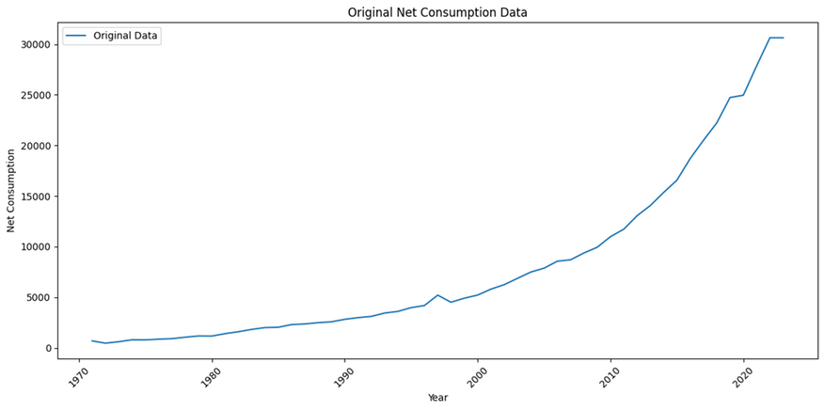
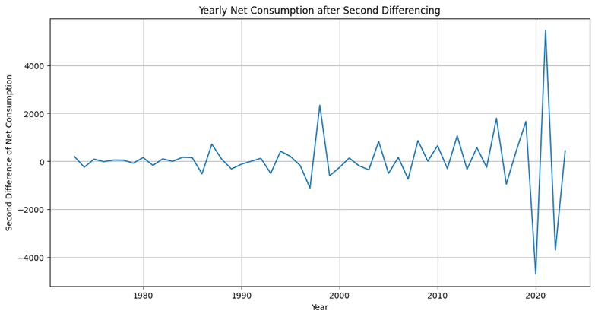
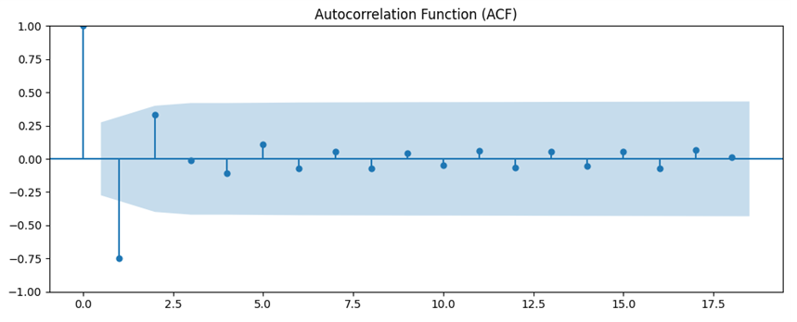

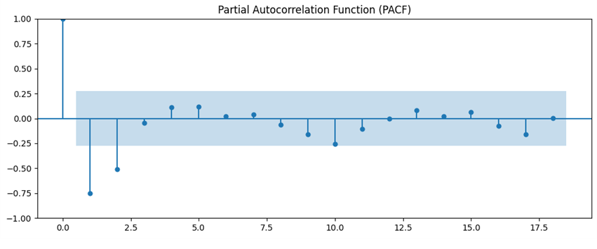
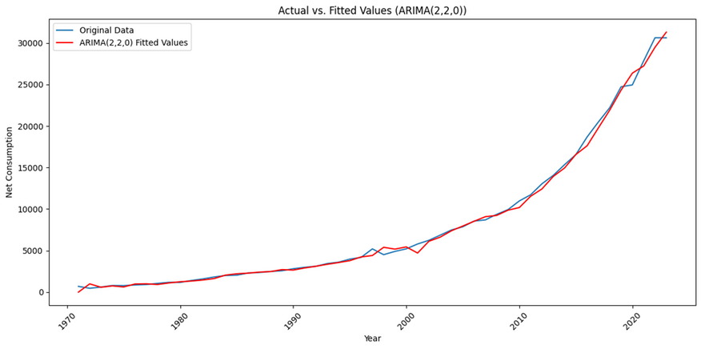

Data Analysis And Results
Page 05
Electricity Consumption (ARIMA)
select P, q from ACF and PACF
Best model: ARIMA(2,2,0)
AIC: 822.745930
BIC: 828.541407
RMSE: 719.77
MAE: 502.35
Ljung-Box Test p-value: 0.8231

Slide 7
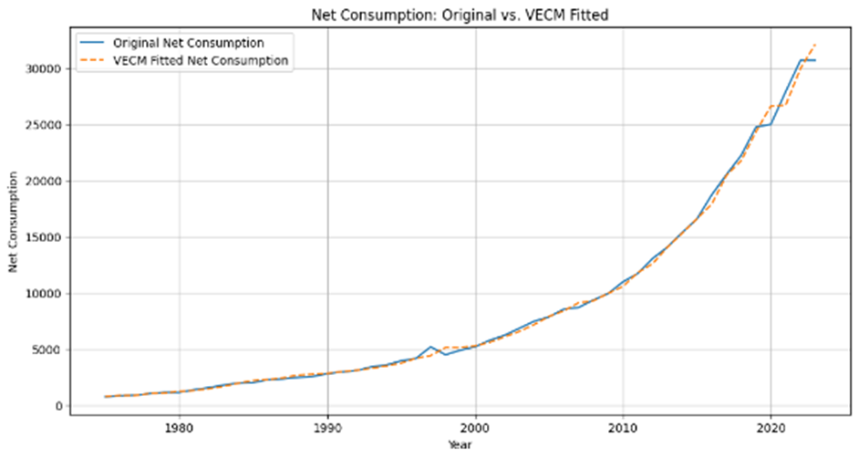
Data Analysis And Results
Page 06
Electricity Consumption (VAR)
Then perform Johansen Cointegration Test and its confirm that data are cointegrated.
VAR model include variable net consumption ,net generation and GDP . All variable data are non stationary . After 1st differencing data does not become stationary .
Optimal lag order of 3 based on AIC and BIC.
RMSE 450.08, MAE 263.88

Slide 8
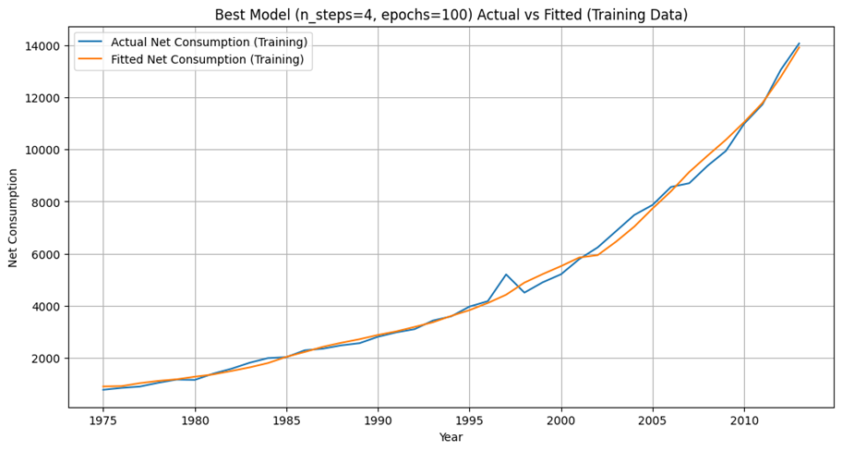
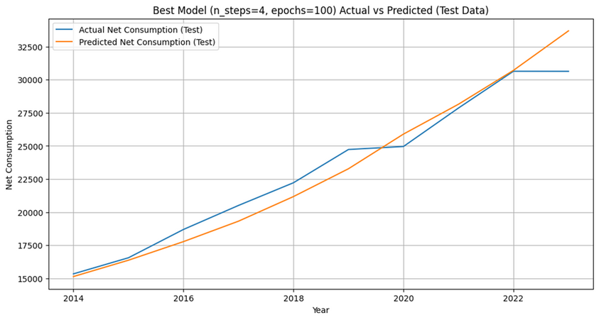
Data Analysis And Results
Electricity Consumption (LSTM)
Page 07
The combination of time steps and epochs
The combination of time steps = 4 and 100 epochs in this LSTM model has Low RMSE and MAE

Slide 9
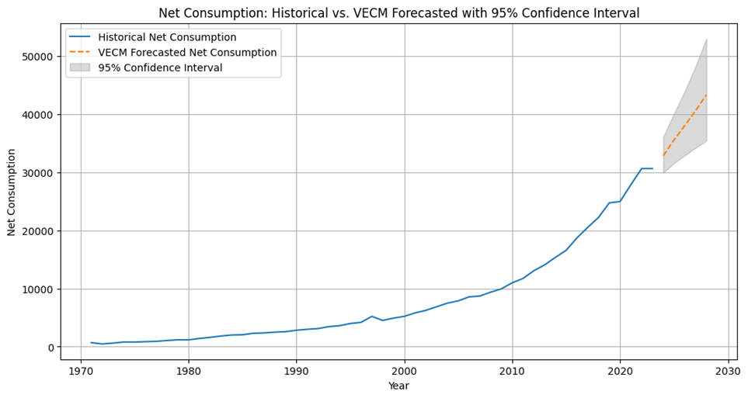
Data Analysis And Results
Page 08
Forecasting Electricity Consumption using Best Model
Model comparison for Net consumption data
steady increase in net consumption over time.
VECM is a great choice for forecasting net electricity consumption.

Slide 10
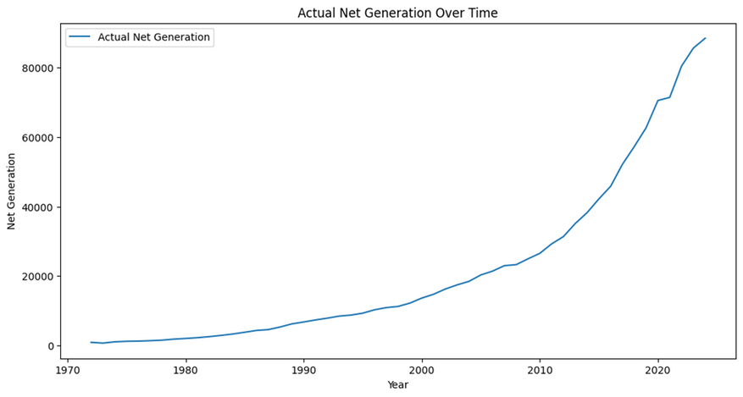
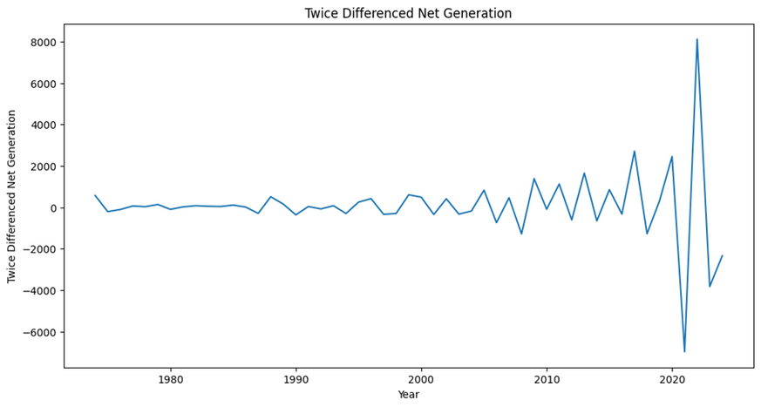
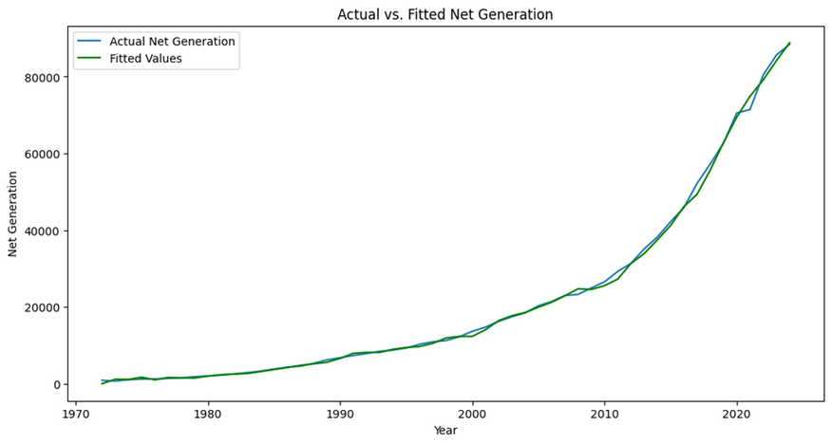
Data Analysis And Results
Page 09
Electricity Generation (ARIMA)
select P, q from ACF and PACF
Best model: ARIMA(2,2,2)
AIC: 852.40432
BIC: 862.063454
RMSE: 912.26
MAE: 596.19
Ljung-Box Test p-value: 0.7731

Slide 11
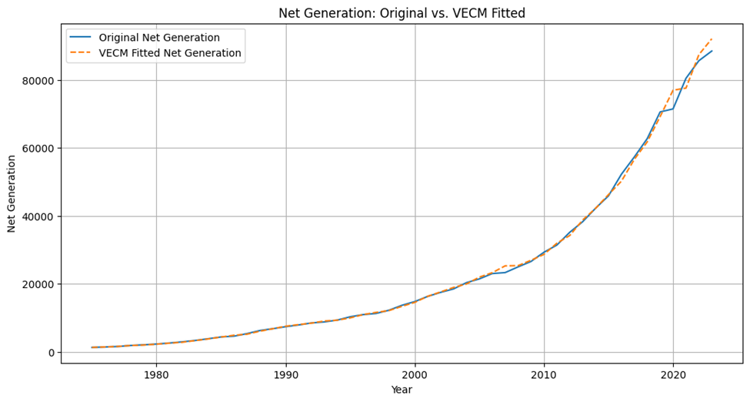
Data Analysis And Results
Page 10
Electricity Generation (VAR)
Then perform Johansen Cointegration Test and its confirm that data are cointegrated.
VAR model include variable net consumption ,net generation and GDP . All variable data are non stationary . After 1st differencing data does not become stationary .
Optimal lag order of 3 based on AIC and BIC.
RMSE 1193.72, MAE 598.63

Slide 12
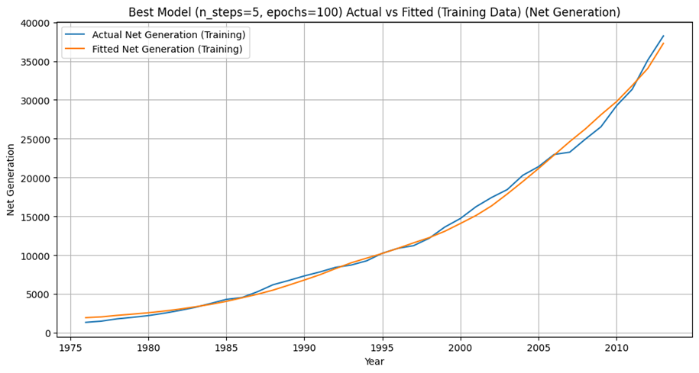
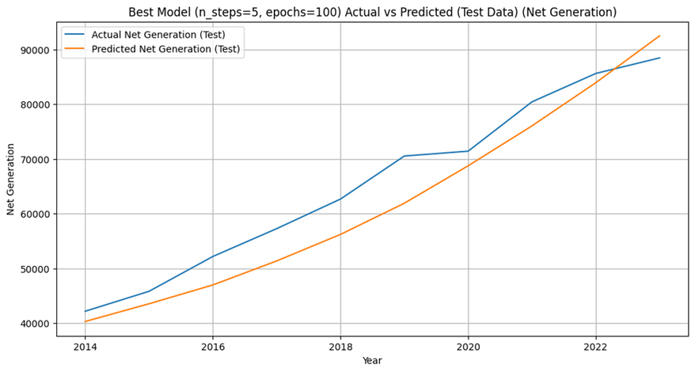
Data Analysis And Results
Page 11
Electricity Generation (LSTM)
The combination of time steps and epochs
The combination of time steps = 5 and 100 epochs in this LSTM model has Low RMSE and MAE

Slide 13
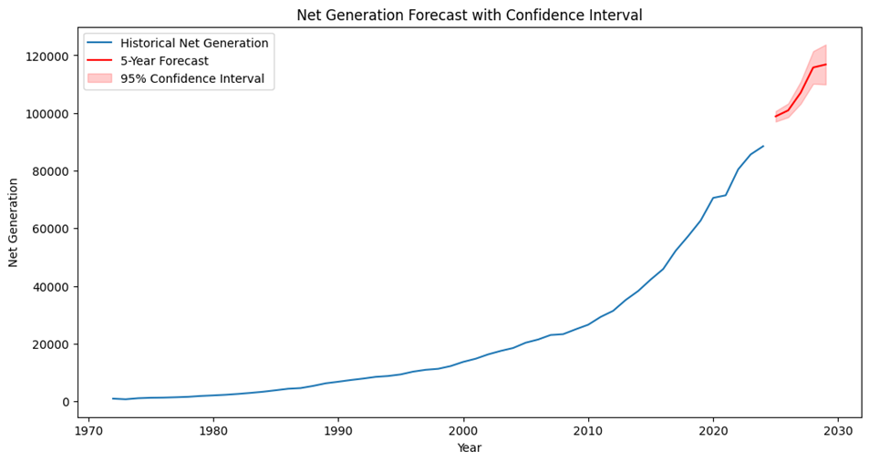
Data Analysis And Results
Page 12
Forecasting Electricity Generation using Best Model
Model comparison for Net consumption data
steady increase in net consumption over time.
ARIMA is a great choice for forecasting net electricity consumption.

Slide 14
Data Analysis And Results
Page 13
Forecasted yearly Electricity Generation And consumption Value

Slide 15
Conclusion
Page 14
ARIMA provides the most accurate results for predicting electricity generation in Bangladesh due to its simplicity and efficiency.
VAR/VECM captures complex factors affecting electricity consumption, offering a detailed understanding.
Forecasts indicate a rise in electricity generation and consumption, requiring increased infrastructure investment to meet growing demand.
Future studies could focus on improving LSTM models, incorporating renewable energy sources, and assessing environmental impacts for a more comprehensive outlook on Bangladesh's energy future

Slide 16
Page 15
Limitations of the Study
Annual Data Only : Using yearly data (1971–2023) masks seasonal, monthly, daily demand fluctuations critical for operational planning.
Small Sample for Deep Learning: With only 53 observations, LSTM models risk overfitting and may not capture genuine patterns.

Slide 17

Thank You

